Slide 1

A Probabilistic Generative Model of Linguistic Typology
Johannes Bjerva
Yova Kementchedjhieva
Ryan Cotterell
Isabelle Augenstein

Slide 2

Languages are different

Slide 3

Languages are different
eat an apple

Slide 4
Languages are different
eat an apple
リンゴを 食べる
ringo-wo taberu

Slide 5

Differences are often correlated
リンゴを 食べる
eat an apple
ringo-wo taberu
go to NAACL

Slide 6
Differences are often correlated
リンゴを 食べる
eat an apple
ringo-wo taberu
go to NAACL
NAACL に 行く
NAACL -ni iku

Slide 7
Linguistic Typology and Greenberg’s Universals
VO languages have prepositions
OV languages have postpositions
Notes:
1963

Slide 8
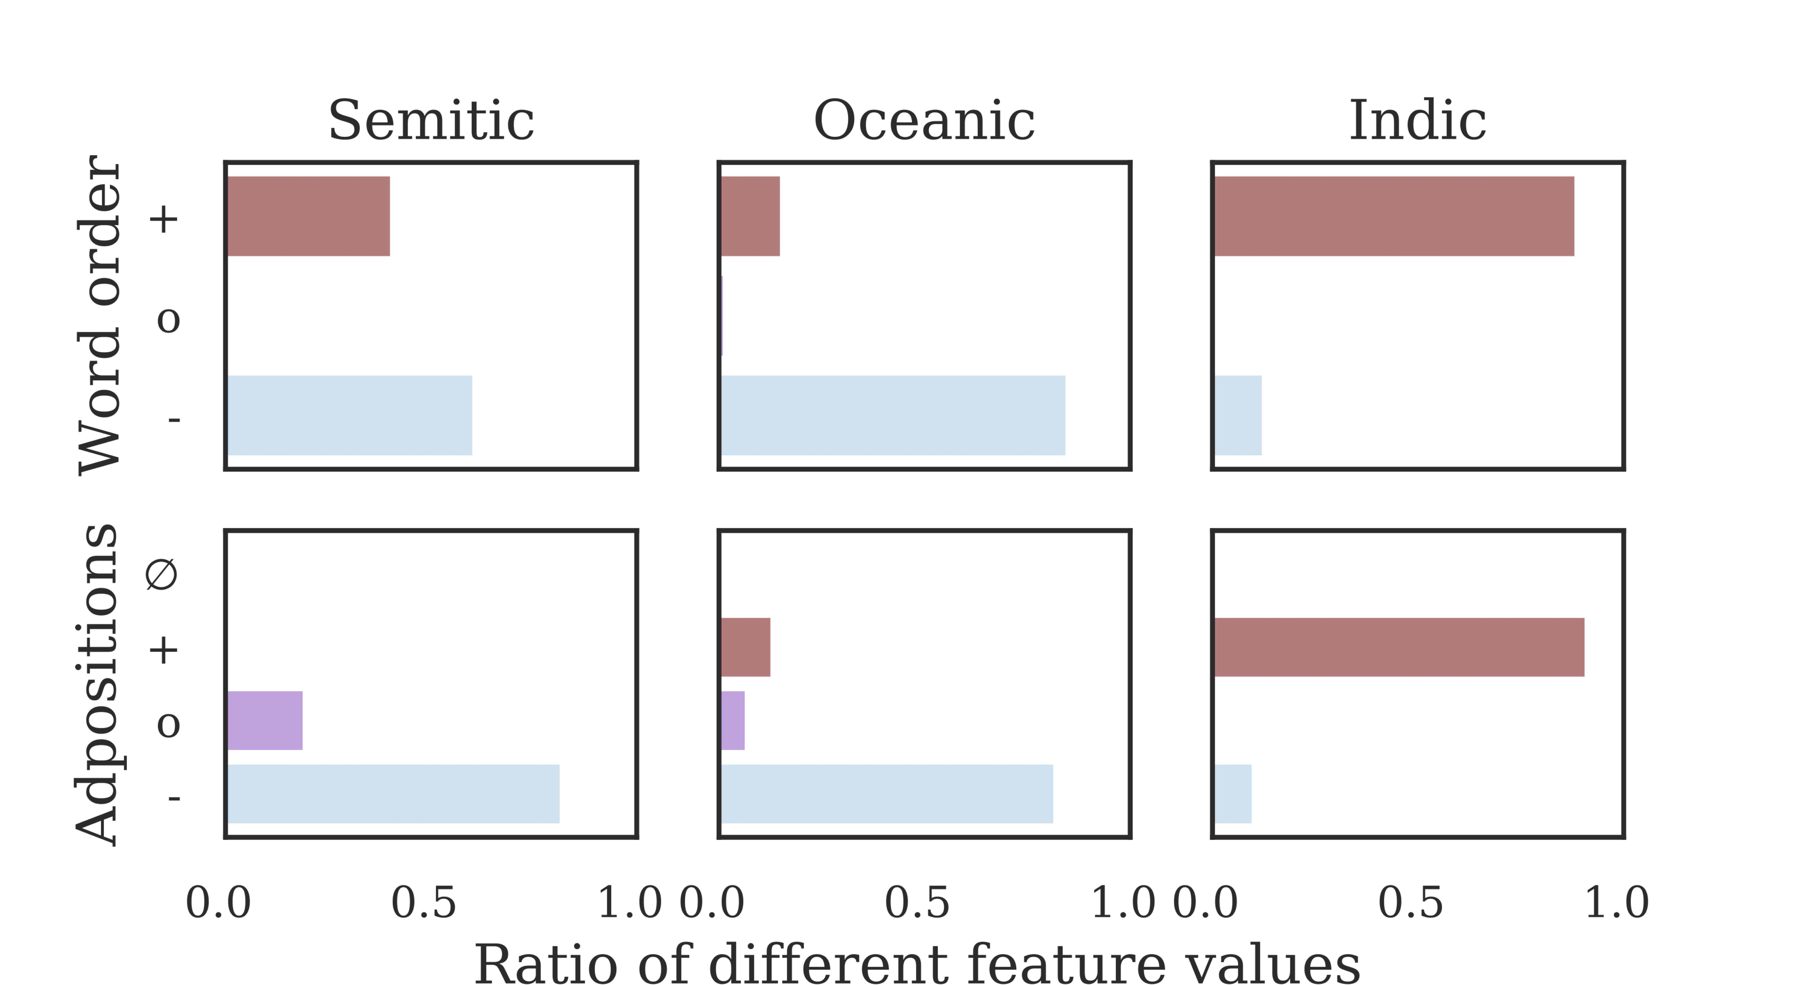
Correlations between Word Order and Adpositions

Slide 9
Contributions
Greenberg’s universals are binary – However, correlations are rarely 100%, so we implement a probabilisation of typology

Slide 10
Contributions
Greenberg’s universals are binary – However, correlations are rarely 100%, so we implement a probabilisation of typology
Framed as typological collaborative filtering, exploiting correlations between languages and features

Slide 11
Contributions
Greenberg’s universals are binary – However, correlations are rarely 100%, so we implement a probabilisation of typology
Framed as typological collaborative filtering, exploiting correlations between languages and features
We exploit raw linguistic data by adding a semi-supervised extension

Slide 12
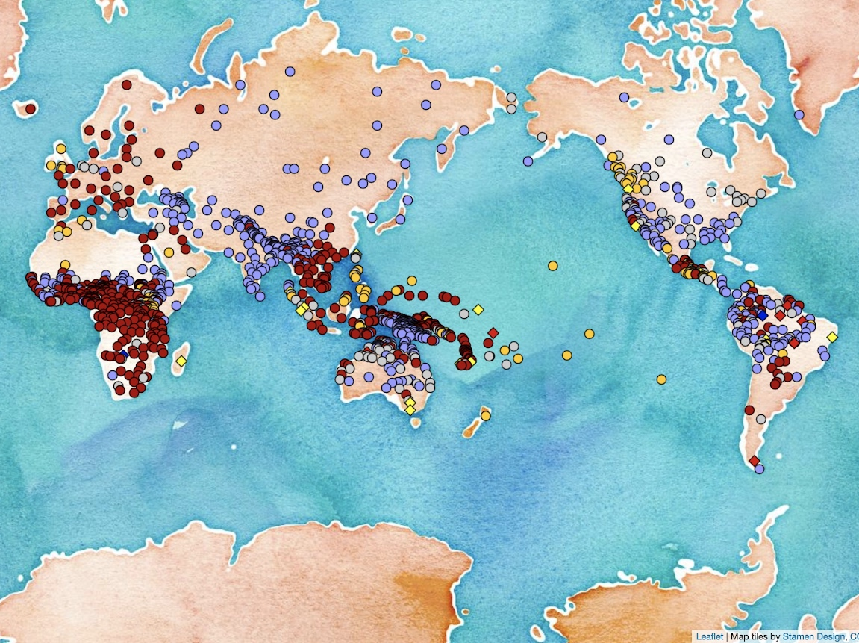
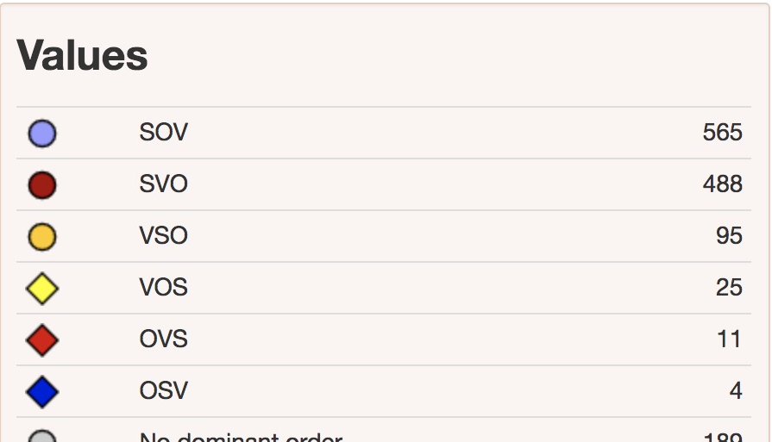
World Atlas of Language Structure (WALS)
Feature 81A – Order of Subject, Object and Verb
Notes:
81A Order of Subject, Object and Verb

Slide 13
World Atlas of Language Structure (WALS)
2,500 languages
192 features
Feature 81A – Order of Subject, Object and Verb

Slide 14
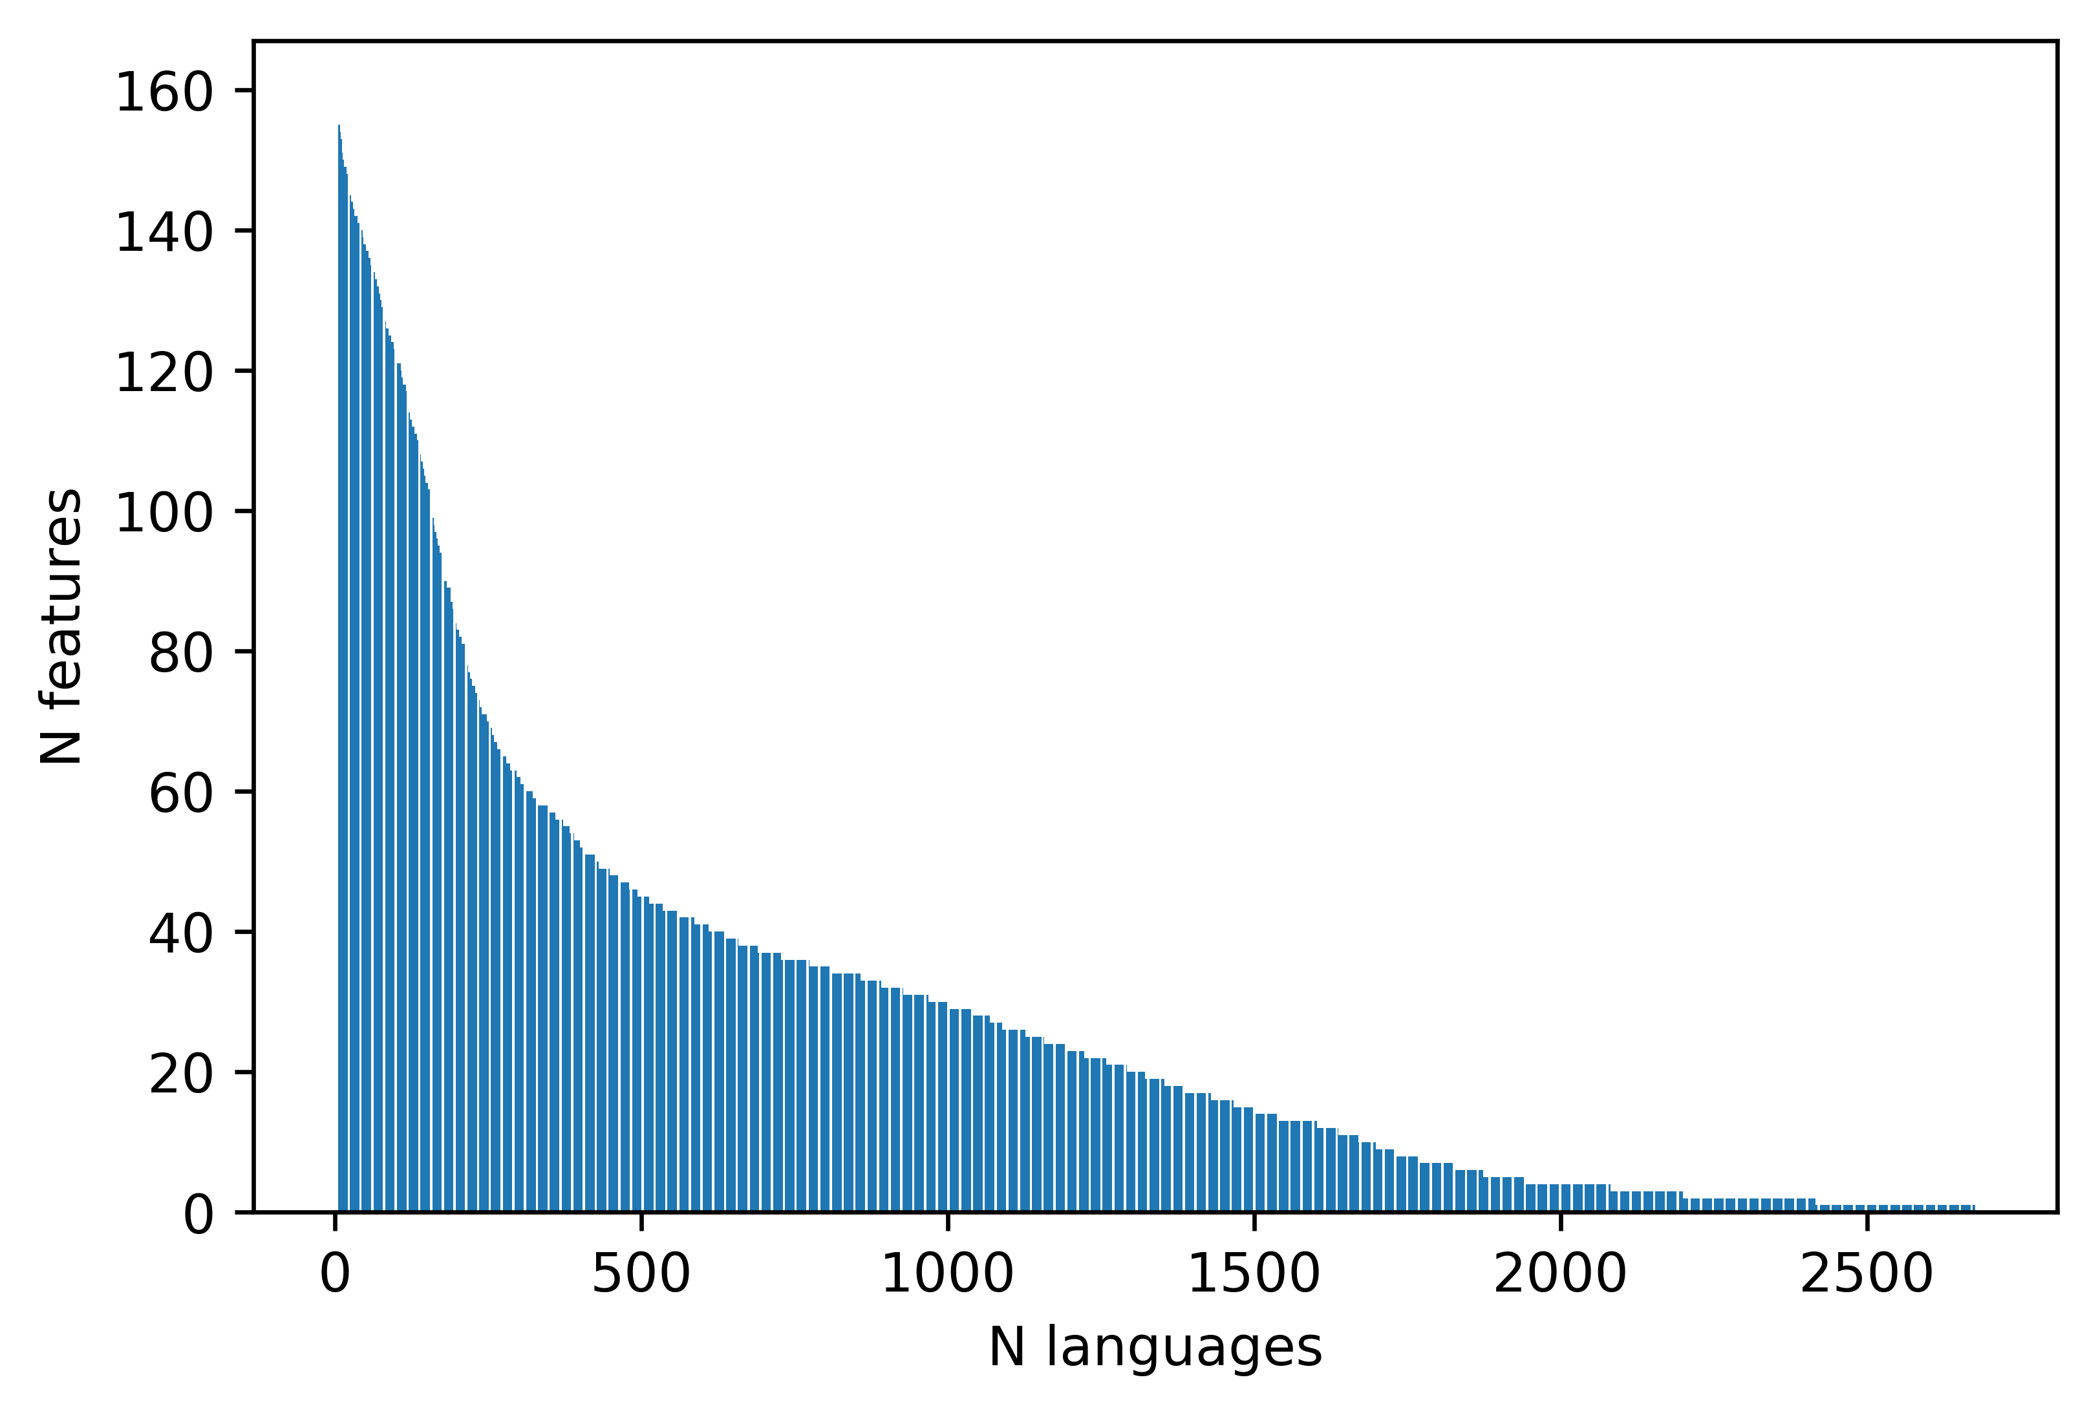
WALS is Sparse and Skewed
Sparse: Most languages are covered by only a handful of features
Skewed: A few features have much wider coverage than others
Notes:
Problem with WALS, part of our motivation
Increase label size
Sparse: definition
Skewed: definition

Slide 15
World Atlas of Language Structure (WALS)
2,500 languages 800 languages
192 features 160 features
Feature 81A – Order of Subject, Object and Verb

Slide 16
Probabilistic Typology as Matrix Factorisation
Notes:
Add logo
Ask Ryan for
Gaussian vs. Binary matrix factorisation

Slide 17
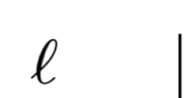
Probabilistic Typology as Matrix Factorisation
Movies
Users
Netflix Challenge
Notes:
Add logo
Ask Ryan for
Gaussian vs. Binary matrix factorisation

Slide 18



Probabilistic Typology as Matrix Factorisation
Movies
Users
Users
Ratings
Notes:
Gaussian vs. Binary matrix factorisation

Slide 19
Probabilistic Typology as Matrix Factorisation
Movies
-37
29
19
29
-20
29
Users
-36
67
77
22
-5
Users
-24
74
12
14
-52
-79
-39
-9
-3
Notes:
Gaussian vs. Binary matrix factorisation

Slide 20
Probabilistic Typology as Matrix Factorisation
Movies
[
[
[
[
[
[
[
-6
-3
2
4
3
-2
9
-2
1
4
3
-2
9
-7
2
4
3
-2
4
3
-2
[
[
[
[
[
[
[
[ 4 1 -5]
-37
29
19
29
-20
29
Users
-36
67
77
22
-5
[ 7 -2 0]
Users
-24
74
12
14
[ 6 -2 3]
[-9 1 4]
-52
-79
-39
-9
-3
Notes:
Gaussian vs. Binary matrix factorisation

Slide 21
Matrix Completion: Collaborative Filtering
[1,-4,3]
[-5,2,1]
Dot Product
-10

Slide 22
Probabilistic Typology as Matrix Factorisation
Movies
[
[
[
[
[
[
[
-6
-3
2
4
3
-2
9
-2
1
4
3
-2
9
-7
2
4
3
-2
4
3
-2
[
[
[
[
[
[
[
[ 4 1 -5]
-37
29
19
29
-20
29
Users
-36
67
77
22
-5
[ 7 -2 0]
Users
-24
74
12
14
[ 6 -2 3]
[-9 1 4]
-52
-79
-39
-9
-3
Notes:
Gaussian vs. Binary matrix factorisation

Slide 23
Probabilistic Typology as Matrix Factorisation
Movies
[
[
[
[
[
[
[
-6
-3
2
4
3
-2
9
-2
1
4
3
-2
9
-7
2
4
3
-2
4
3
-2
[
[
[
[
[
[
[
[ 4 1 -5]
-37
29
19
29
-20
29
Users
-36
67
77
22
-5
-21
[ 7 -2 0]
Users
-24
61
74
12
70
14
[ 6 -2 3]
[-9 1 4]
-52
-79
-39
-41
-9
-3
Notes:
Gaussian vs. Binary matrix factorisation

Slide 24
Probabilistic Typology as Matrix Factorisation
Typological Features
Languages
WALS Challenge

Slide 25
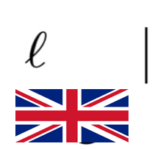
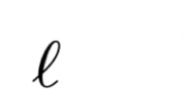
Probabilistic Typology as Matrix Factorisation
Typological Features

Slide 26

Probabilistic Typology as Matrix Factorisation
Typological Features

Slide 27

Probabilistic Typology as Matrix Factorisation
Typological Features

Slide 28

Probabilistic Typology as Matrix Factorisation
Typological Features

Slide 29
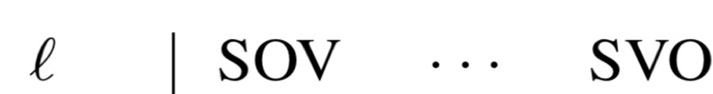
Probabilistic Typology as Matrix Factorisation

Slide 30
Probabilistic Typology as Matrix Factorisation

Slide 31
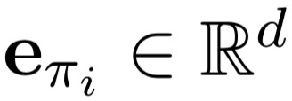
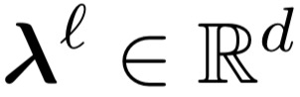
Probabilistic Typology as Matrix Factorisation

Slide 32





Typological Feature Prediction
Notes:
Controlling for genetic relationships

Slide 33
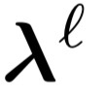
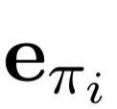
Probabilistic Typology as Matrix Factorisation
Dot Product
4
Sigmoid
0.9
Notes:
0.6

Slide 34
Typological Feature Prediction

Slide 35
Semi-supervised Extension
Typological Feature Prediction

Slide 36
Semi-supervised Extension
Multilingual Language Modelling
Typological Feature Prediction
Notes:
Long term goal – interpretable for linguists

Slide 37

Representing Languages – Semi-supervised Extension
Language embeddings from multilingual language modelling (Östling and Tiedemann, 2017)
k a t
<s> k a
Notes:
IA: For the semi-supervised extension, I’ve found people struggle to make the link between language modelling and inducing language vectors unless it’s really spelled out for them. Make sure to say this in your talk and also perhaps highlight the language vectors visually, already in the first slide about it

Slide 38
Representing Languages – Semi-supervised Extension
Language embeddings from multilingual language modelling (Östling and Tiedemann, 2017)
Trained on massively multilingual corpora
~975 languages
k a t
<s> k a
Notes:
IA: For the semi-supervised extension, I’ve found people struggle to make the link between language modelling and inducing language vectors unless it’s really spelled out for them. Make sure to say this in your talk and also perhaps highlight the language vectors visually, already in the first slide about it

Slide 39
Representing Languages – Semi-supervised Extension
k a t
<s> k a

Slide 40
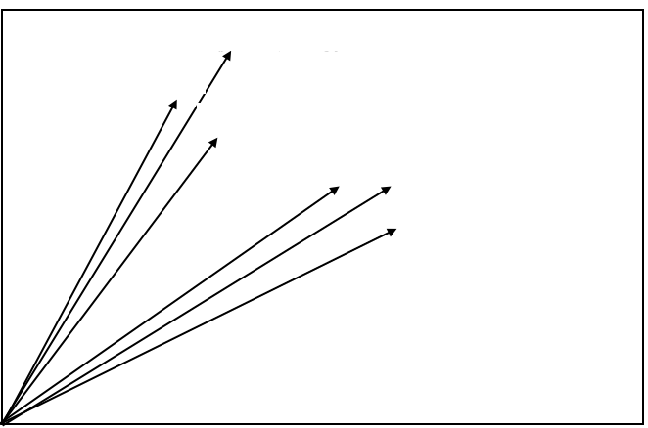






Representing Languages – Semi-supervised Extension
k a t
<s> k a

Slide 41
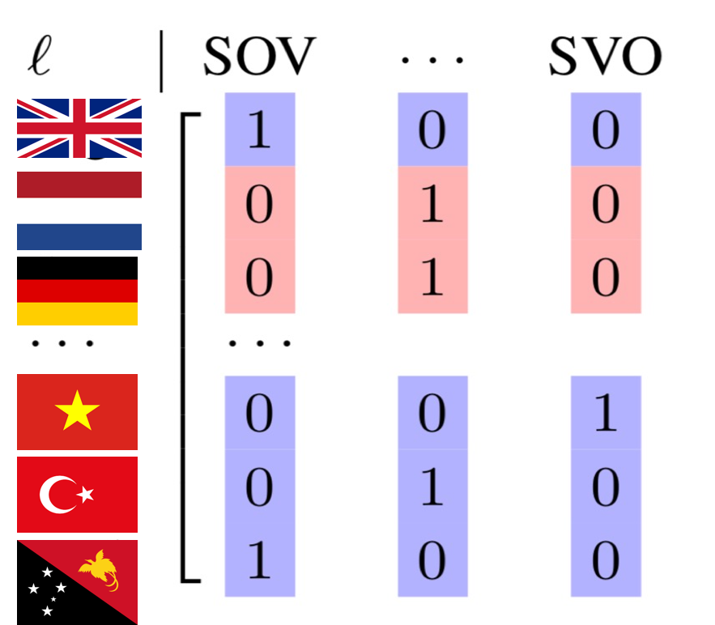
Representing Languages – Semi-supervised Extension
k a t
<s> k a

Slide 42
Semi-supervised Extension - Interpretability
Multilingual Language Modelling
Typological Feature Prediction
Compressing linguistic information

Slide 43
Evaluation
Controlling for Genetic Relationships
Train on all out-of-family data
[0, 1, 5, 10, 20]% in-family data
Observed features in matrix

Slide 44
Evaluation
Controlling for Genetic Relationships
Train on all out-of-family data
[0, 1, 5, 10, 20]% in-family data
Observed features in matrix
With/without pre-trained language embeddings
Notes:
Controlling for Genetic Relationships -

Slide 45
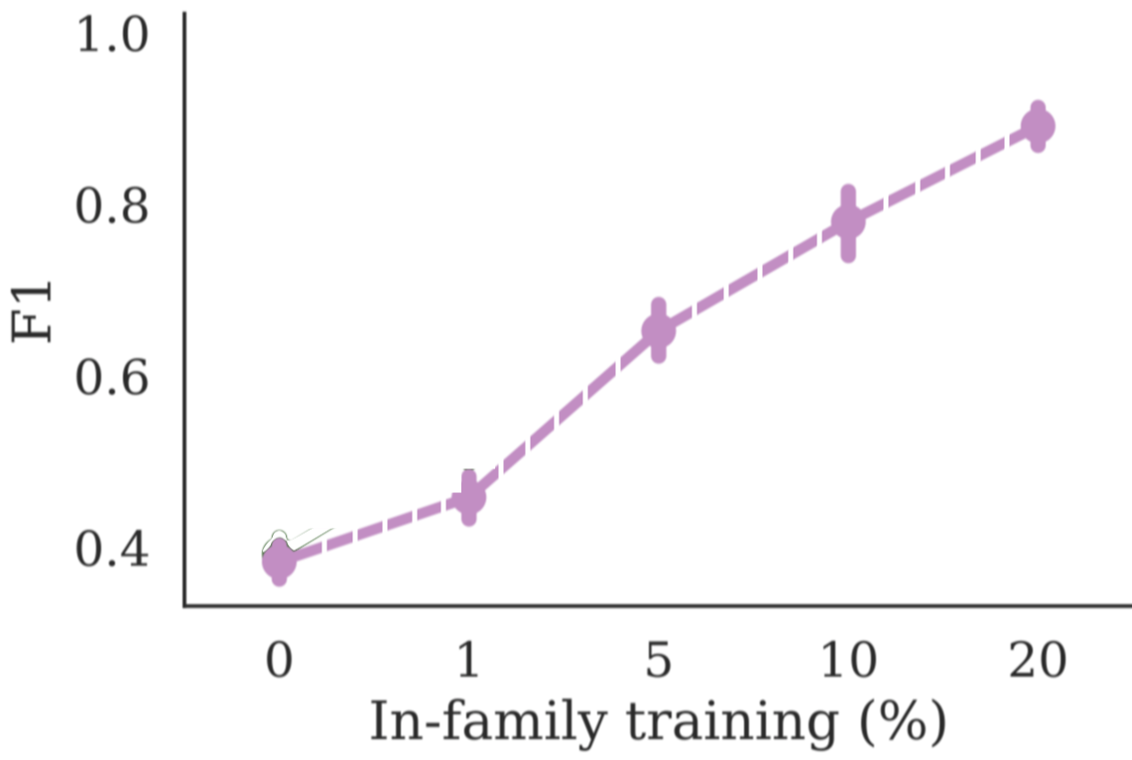
Feature Prediction across Language Families
Notes:
Entries in the Matrix

Slide 46
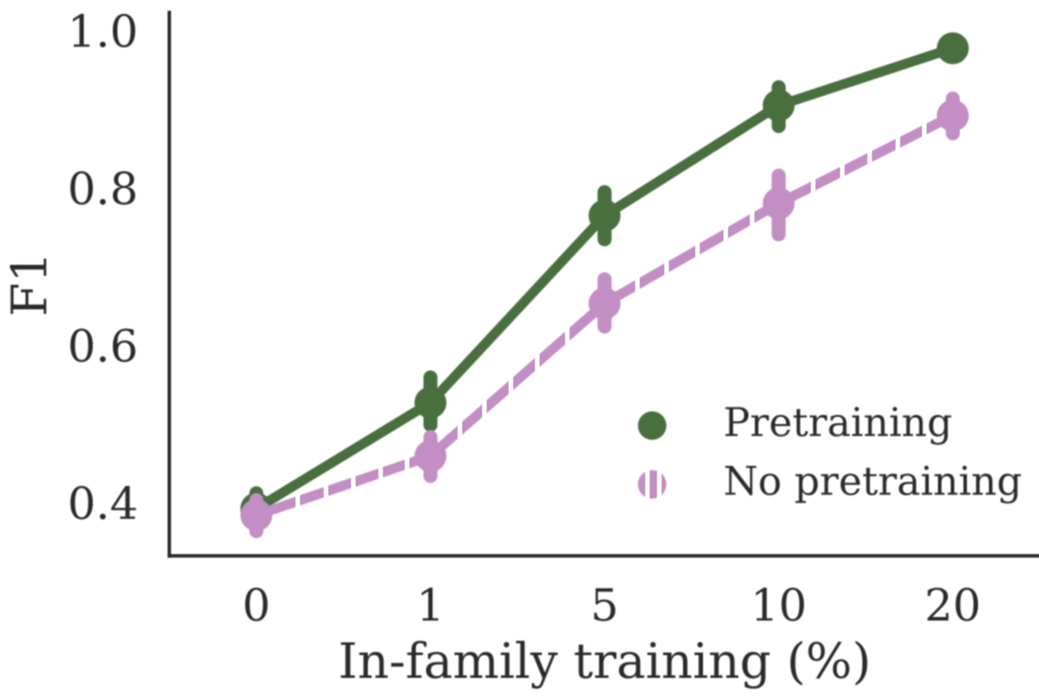
Effect of Pre-training (Semi-supervised Extension)

Slide 47
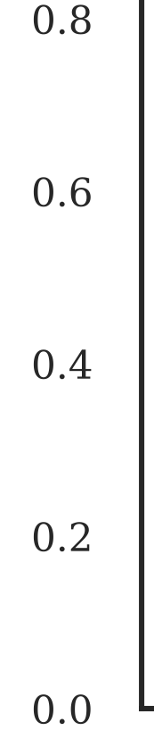
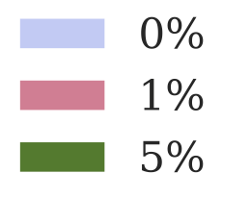


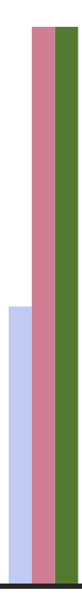

In-family data
F1
Morphology
Phonology
Notes:
Point out Phonology
Cut down
Show Norwegian/Danish language

Slide 48
Semi-supervised
In-family data
Semi-supervised
F1
Morphology
Phonology
Notes:
Point out Phonology
Cut down
Show Norwegian/Danish language

Slide 49
Contributions
Probabilisation of linguistic typology
Typological collaborative filtering, exploiting correlations between languages and features
Semi-supervised extension, allowing for use of raw text
Notes:
Pictures for contributions

Slide 50
Upcoming Papers
Extending from correlations to uncovering probabilistic implications ACL 2019 [Pre-print on arXiv soon]
Investigating relationships between language representations CL journal 2019 [Pre-print on arXiv]
Notes:
Ideas +

Slide 51
Thank you!
Questions?

Slide 52
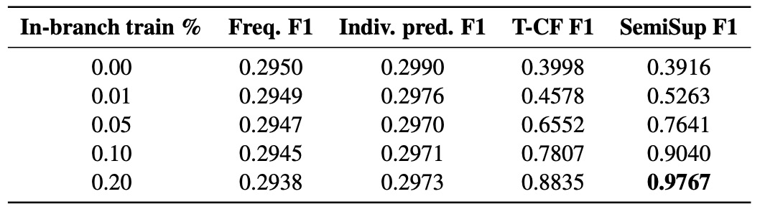
Baseline comparisons

Slide 53
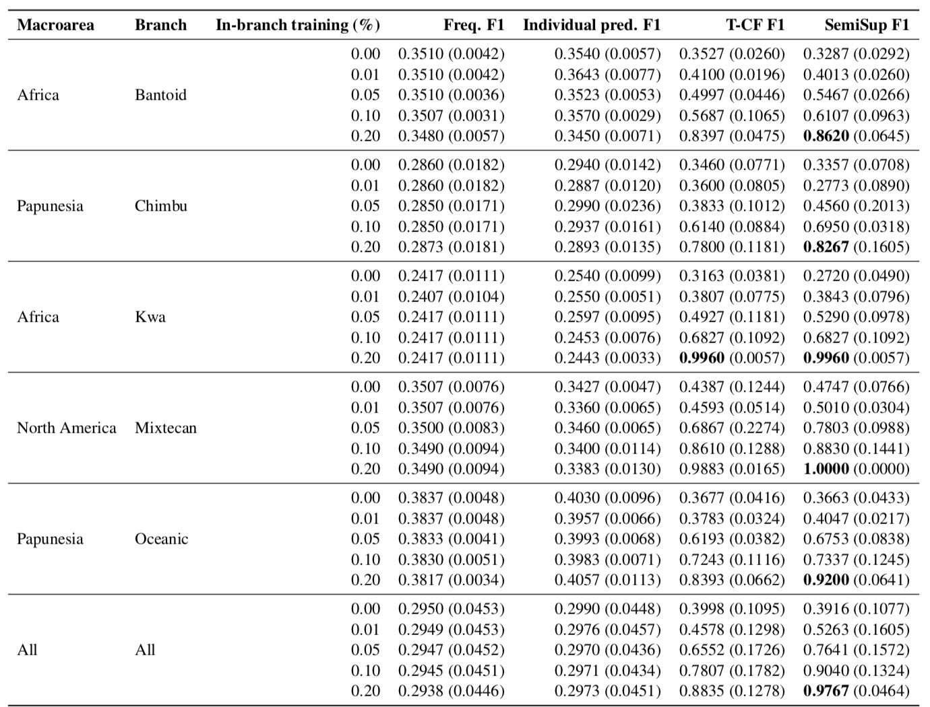

Slide 54
Feature Prediction split up across Macro-Areas
Notes:
Why is this worse in Africa?

Slide 55
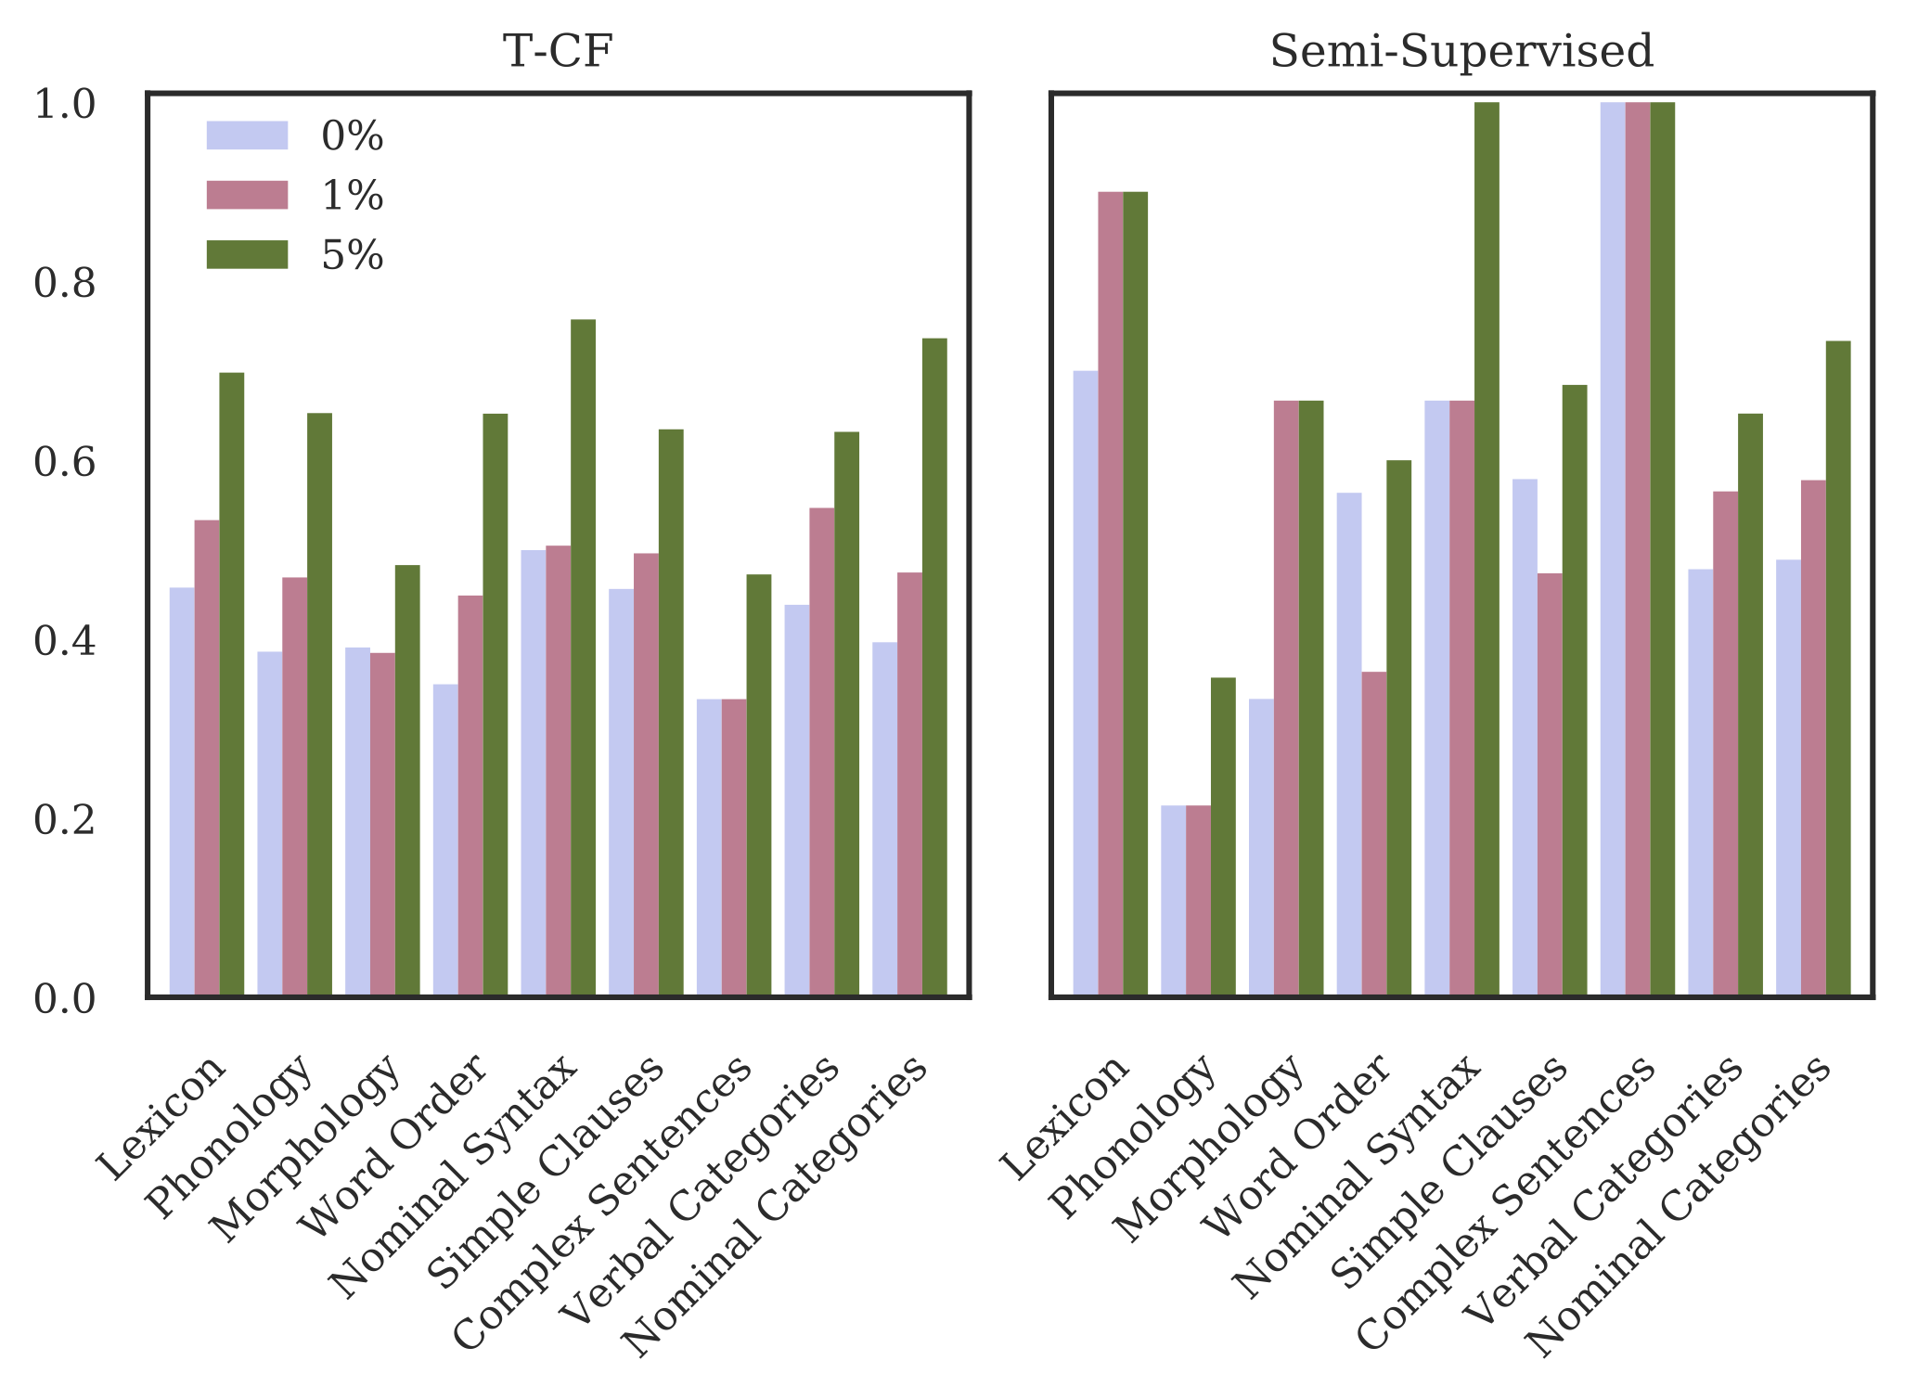
Notes:
Point out Phonology
Cut down
Show Norwegian/Danish language

